Slide 1
Bell Ringer 8/24 Pick an explorer from last year and describe his travels.
Pineda, cabeza de vaca, cortez, la salle

Slide 2
Colonization Concepts

Slide 3
What is…

Slide 4
Consequences

Slide 5
Colonization
the act of establishing a settlement under control/governance of another power
Example:
Mission – Presidio System
Synonym:
Settlement

Slide 6
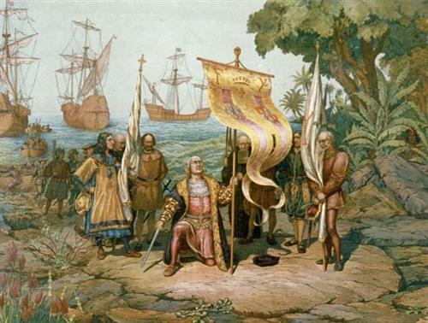
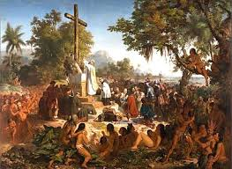
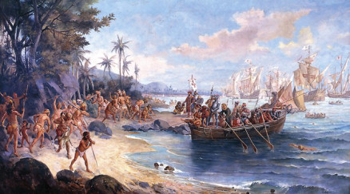

Slide 7
Push-Pull
The push factor involves a force which acts to drive people away from a place and the pull factor is what draws them to a new location.
Example:
Galveston Hurricane
Synonyms:
Immigration

Slide 8
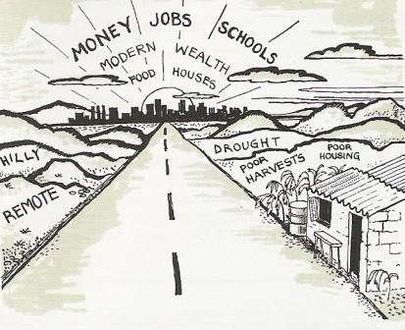
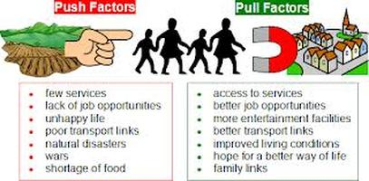
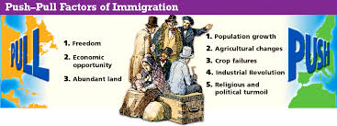

Slide 9
Mercantilism
an economic system in which a country accumulates wealth by exporting more than it imports (favorable balance of trade) vid
Example:
The North’s exportation of manufactured goods to South
Synonyms :
Commercialism

Slide 10
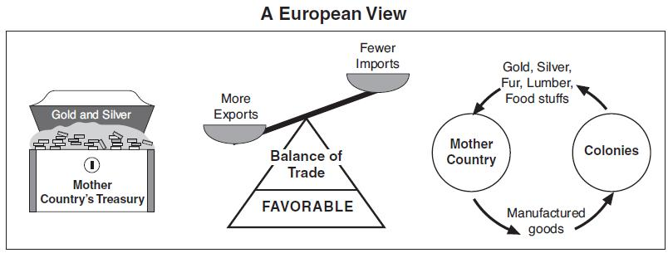
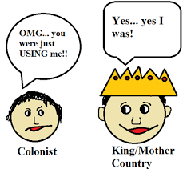
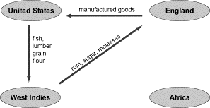

Slide 11
Define on your own
Political – (not in your book)
Social – (not in your book)
Economic – (not in your book)
Charter –
Physical Geography – (not in your book)

