Slide 1
Exploration and Colonization
Bell ringer 8/25:
Why do people move?

Slide 2
Review
Last year what did we call the reasons for Spanish exploration?
3 Gs of Exploration
What were the 3 Gs?
God
Gold
Glory

Slide 3
Reasons for Exploration
Political | Economic | Social
Compete with growing empires of other European nations | Find faster routes to Asian markets | Spread Christianity
 | Search for gold and other natural resources | Explorers wanted fame, fortune, and power
Predict:
What steps will European nations take next as a result of exploration?
Once you have claimed land, what do you need to do to ensure no one else takes it?

Slide 4
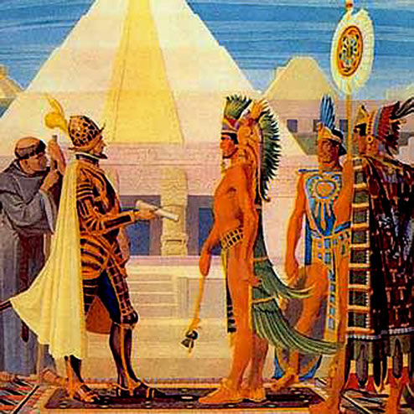
Reasons for Colonization
Spain
Search for gold and silver
Conquer and convert natives using the _____________ system.

Slide 5
Reasons for Colonization
France
Establish fur trade
(where do you think they will colonize?)
Make alliance with natives

Slide 6
Reasons for Colonization
England
Mercantilism – spend less on imports, establish new markets for exports
Catch up with Spain and France in colonization
Search for rumored gold and silver

Slide 7
Reasons for Colonization
All Three
Use the America’s natural resources and markets for trade
Find faster routes to Asia
Compete with other nations

Slide 8
Push-Pull Factors

Slide 9
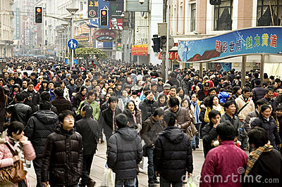
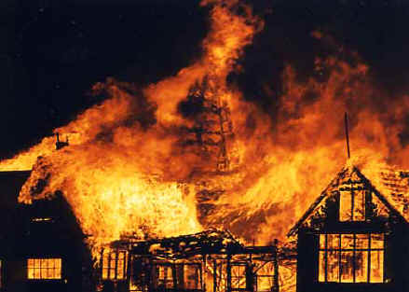
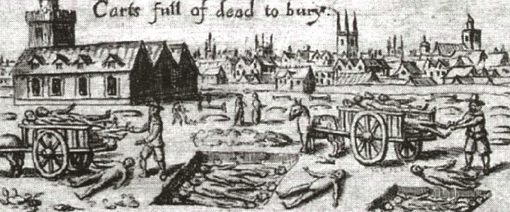
1.

Slide 10
2.

Slide 11
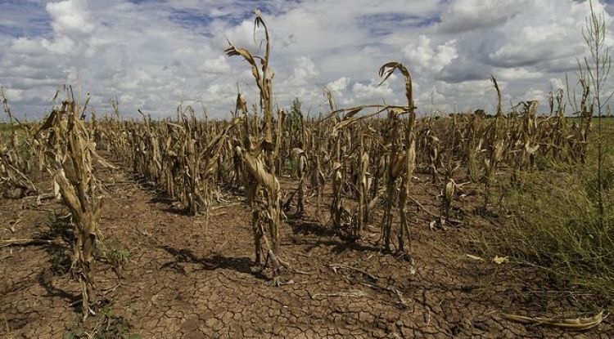
3.

Slide 12
4.

Slide 13
5.

Slide 14
6.

Slide 15
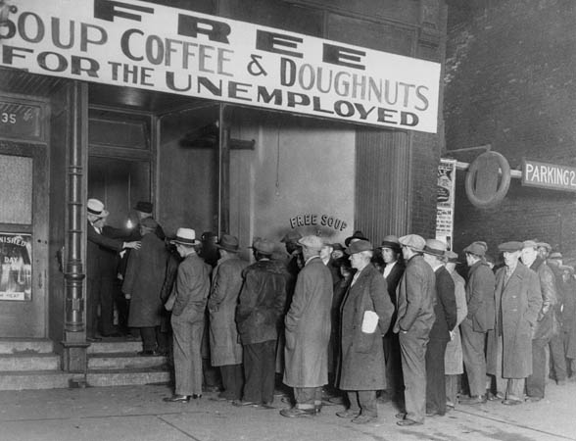
7.

Slide 16
8.

Slide 17
Sorting
Now take the 9 descriptions and sort them into push or pull factors.
Push – something forcing people to leave
Pull – something drawing people to the new land

Slide 18
Push-Pull Factors
Push | Pull
High unemployment caused by nobles who forced tenants off farmlands | Free/low cost land
Overcrowded cities were hit hard by plagues and fires | Profit from various economic activities
Crop failures and famines | Social mobility as a result of economic success
Religious groups that differed from the Church of England faced persecution | Travel to New World through indentured servitude
 | Religious freedom

