Slide 1
Bell Ringer 9/1
Write Agenda.
Use Jamestown worksheet to fill in the chart.

Slide 2
Plymouth

Slide 3
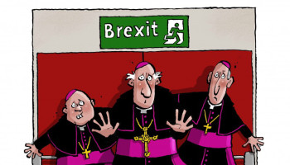
England Breaks Away
In 1534, England broke away from the Catholic Church
Formed the Anglican Church

Slide 4
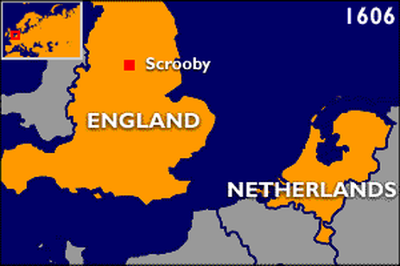
Dissention
Many people dissented the ideas of the Anglican church and were persecuted
Some of these people wanted to form their own church, they were called Separatists

Slide 5
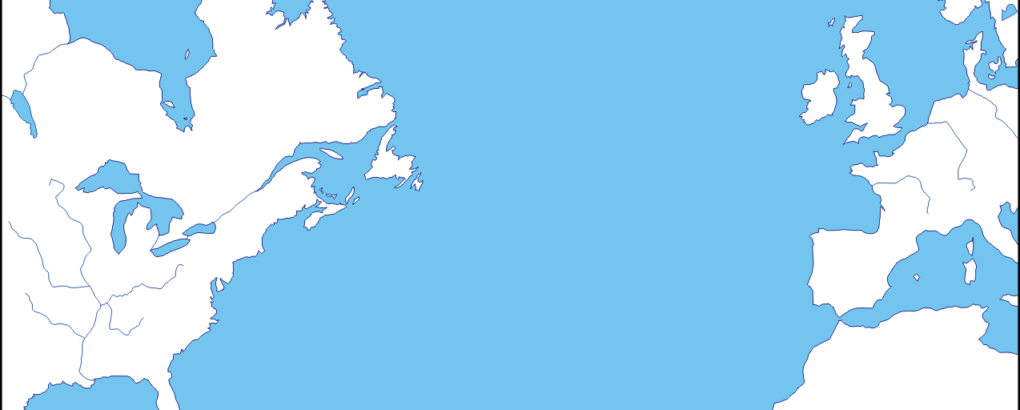
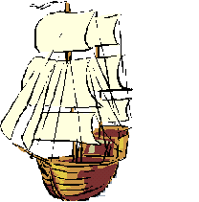
The New World
These Separatists received permission to move to America
What do you think was one reason the Separatists wanted to move to the New World?

Slide 6
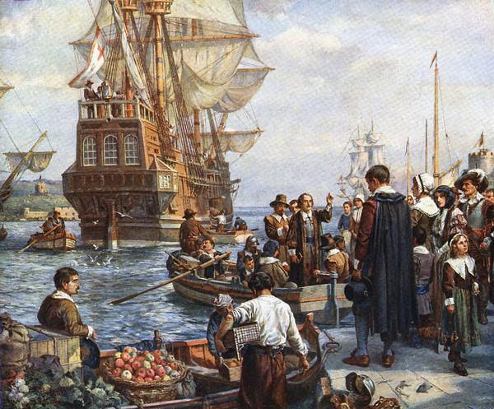

Slide 7
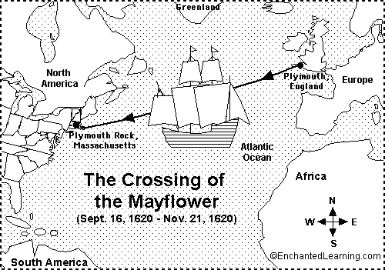
Plymouth, Massachusetts
Separatists received land grants from the Virginia Company
These people became known as Pilgrims and took the Mayflower over to the New World
Landed in present day Massachusetts and called the land Plymouth

Slide 8
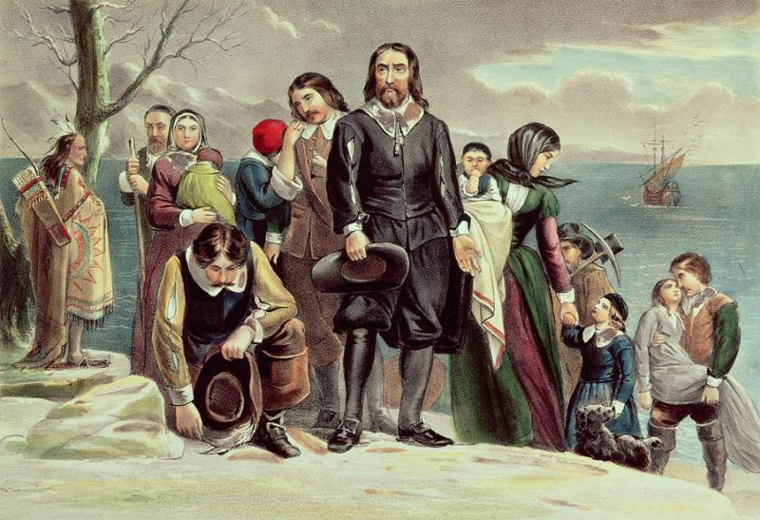

Slide 9
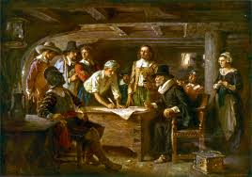
Mayflower Compact
Pilgrims signed the Mayflower compact
Social contract set up a government to make laws
One of the first examples of self-government in the colonies

Slide 10
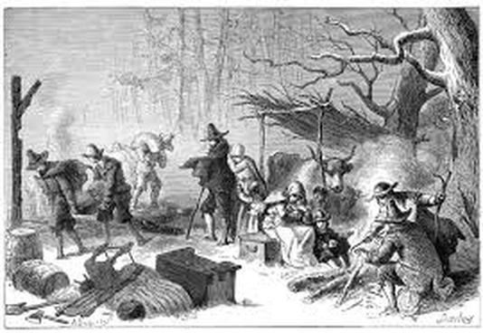
Hardships
The Pilgrims arrived in December
Almost half died because of illness, hunger, and cold

Slide 11
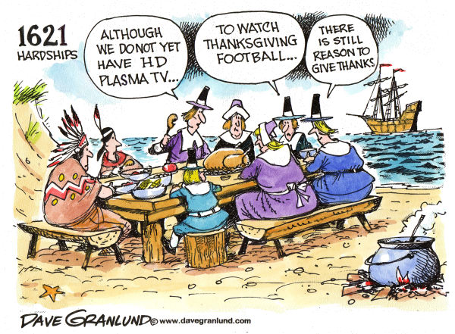
Thanksgiving
During the spring, Squanto and Samoset helped the Pilgrims learn how to farm and where to fish and hunt.
Made peace with Wampanoag
THANKSGIVING!!!

