Slide 1
Bell Ringer 8/29
What are the four rivers we labeled on our US Map?

Slide 2
Four Corners
Which of the following is the better movie?
Guardians of the Galaxy
Tanlged
Frozen
Batman vs. Superman

Slide 3
Four Corners
If you could visit anywhere, where would you want to go?
Swamp
Beach
Desert
Forest

Slide 4
Four Corners
Where would you go if you were looking to make a profit?
Swamp
Beach
Desert
Forest

Slide 5
Roanoke and Jamestown
Early English Colonization

Slide 6
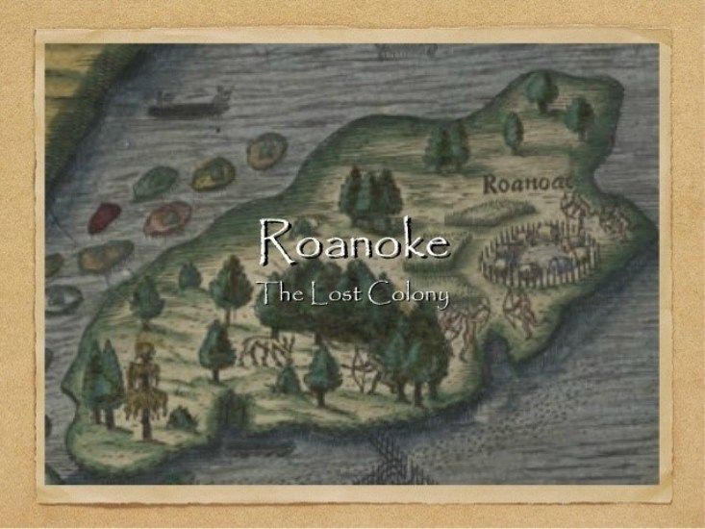
Roanoke
First colony established by the British in 1587
Their leader John White left for 3 years to return to England for supplies
He left his family (Virginia Dare) in the American settlement

Slide 7
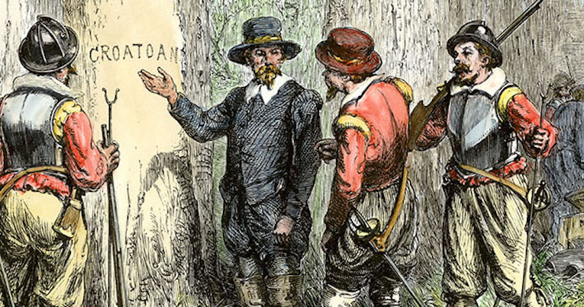
What Happened?
No one really knows
When John White came back only the remains of one dead body was left
And the word “Croatan” carved into the tree
https://www.youtube.com/watch?v=i9341QShjL8

Slide 8
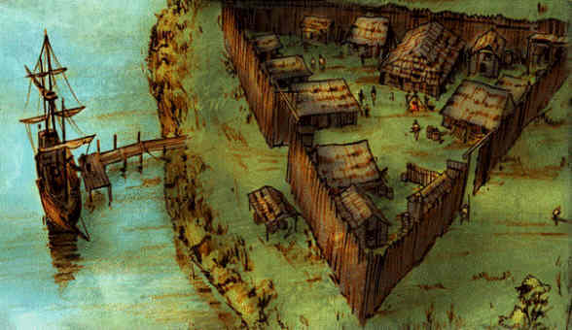
Jamestown – The first successful Colony
Jamestown was established in 1607
It was a disaster too at first. Why do you think it was hard to start up a colony in the New World?
Jamestown will pull itself together and become a leader in Tobacco export and set up the first representative government in the Americas.

