Slide 1
Tensions Rise

Slide 2
What We’ve Discussed So Far
1763 - End of French and Indian War
1764 – Sugar Act
1773 – Tea Act
1765 - Quartering Act
1763 – Proclamation of 1763
1765 – Stamp Act
1767 – Townshend Acts

Slide 3
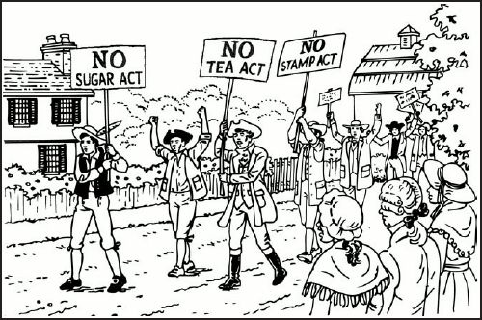
No Taxation Without Representation

Slide 4
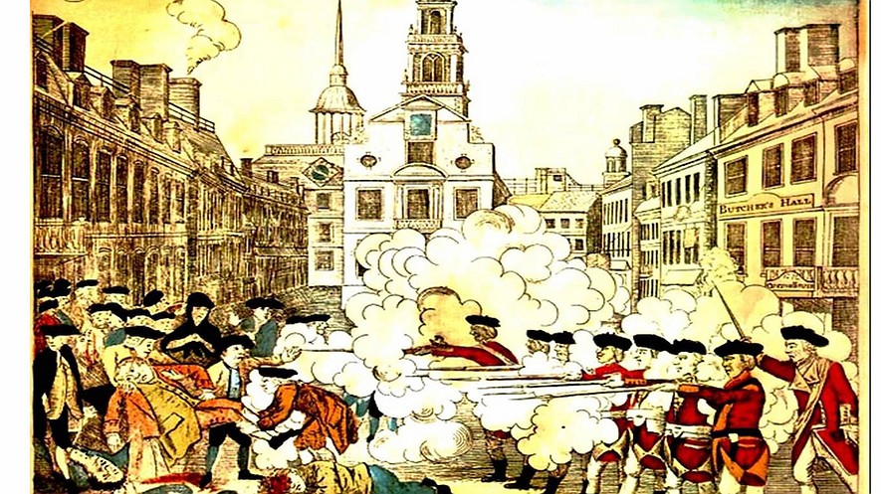
Boston Massacre (1770)
Aggressive colonial mob protesting the taxes and occupation of the British Army
Began throwing sticks and stones at the soldiers
British soldiers fired at the mob, killing 5

Slide 5
Boston Massacre (1770)
Crispus Attucks was the first casualty (African and Native American)
Sons of Liberty
Paul Revere’s The Bloody Massacre (Propaganda)

Slide 6
Boston Massacre (1770)
Sons of Liberty

Slide 7
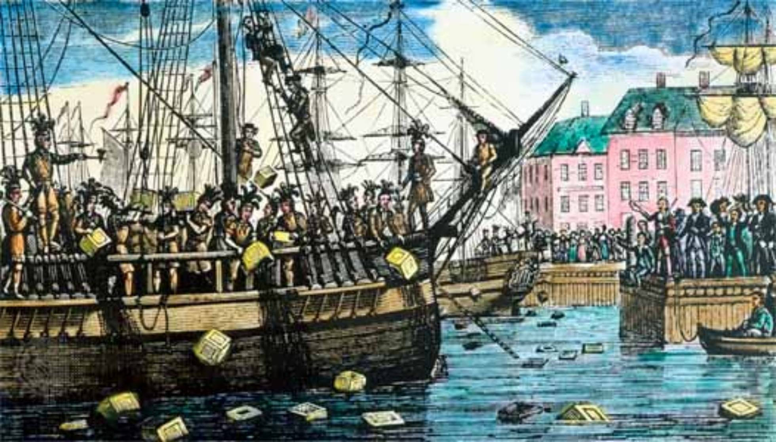
Boston Tea Party (1773)
Sons of Liberty dumped British East India Tea into Boston Harbor to protest Tea Act
Sons of Liberty – colonial protest group led by Samuel Adams
Boston Tea Party
What will be Britain’s response?

Slide 8
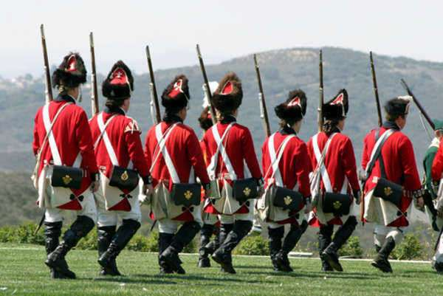
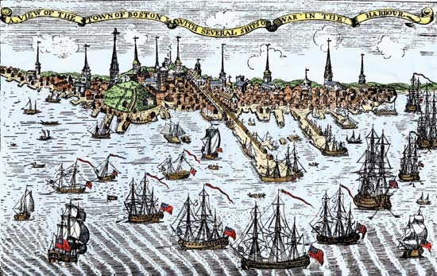
Intolerable Act (1774)
British reaction to the Boston Tea Party
Closed the Boston port
More troops
Replaced colonial governments with royalty-appointed government

Slide 9
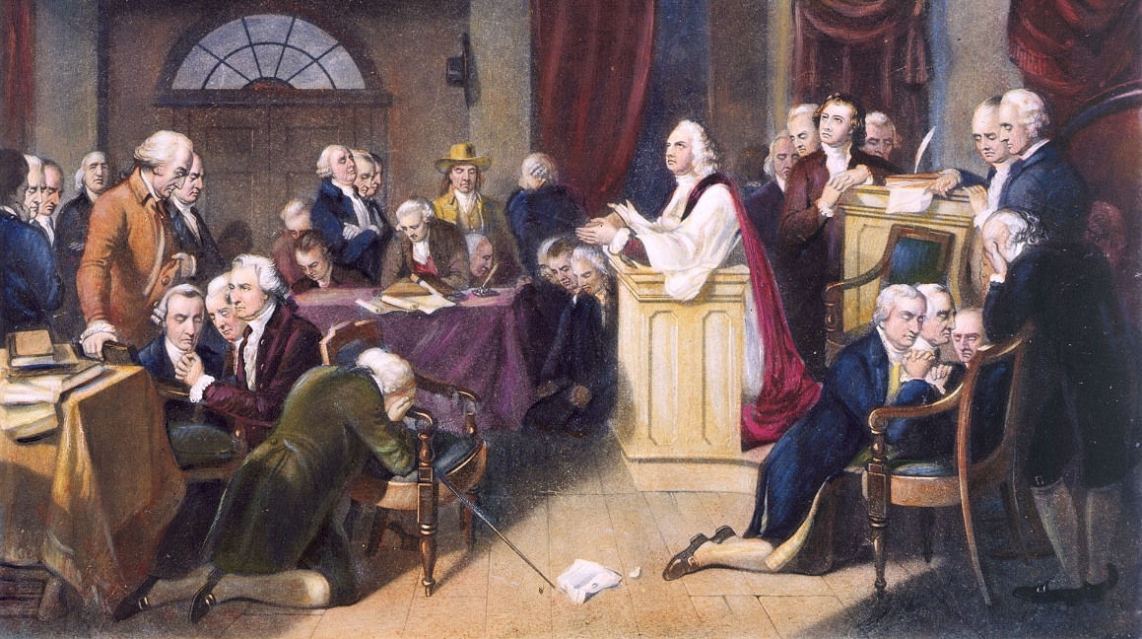
First Continental Congress (1774)
Colonial response to Intolerable Acts
Called for boycott of British goods
Petitioned King George II to listen to the colonist’s grievances
Urged colonies to begin training militias
Significance
Set precedent for ongoing colonial unity and leadership

